Slide 1
BB2950 Day 17: Tuesday 11-21-17
Learning objectives:
Explain how mismatches and damaged bases cause point mutations and other types of mutations.
Describe some of the common causes of mismatches and DNA damage.
Explain how translesion synthesis polymerases replicate damaged DNA.

Slide 2
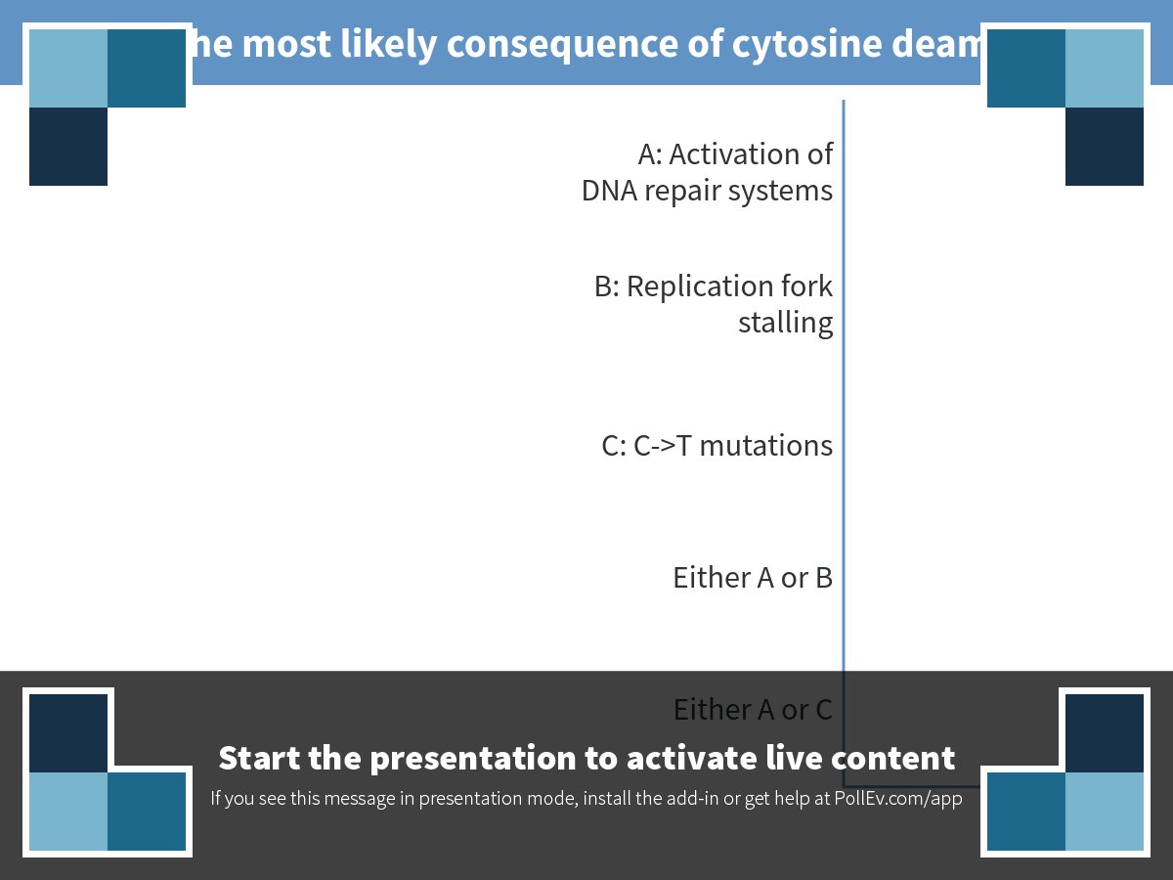
Notes:
What is the most likely consequence of cytosine deamination?
https://www.polleverywhere.com/multiple_choice_polls/nw7X6ryLRd7bmfi

Slide 3
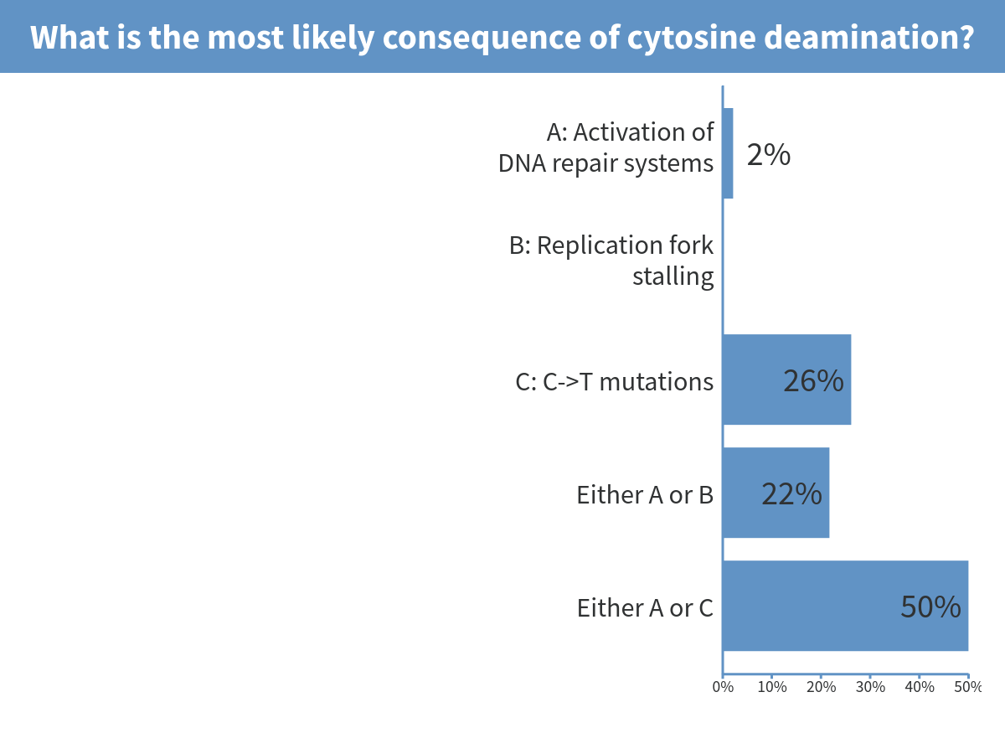
Notes:
What is the most likely consequence of cytosine deamination?

Slide 4
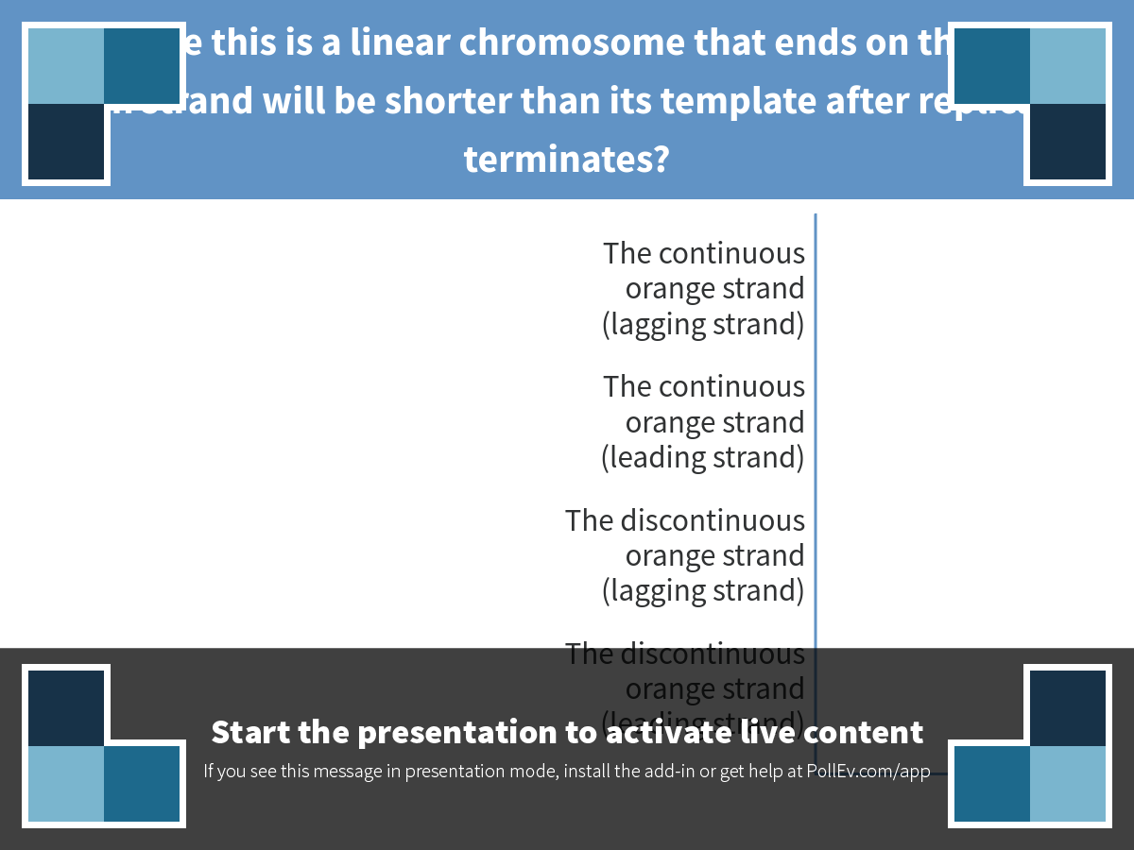
Notes:
Suppose this is a linear chromosome that ends on the right. Which strand will be shorter than its template after replication terminates?
https://www.polleverywhere.com/multiple_choice_polls/RgyoVnP9b8ZvLi4

Slide 5
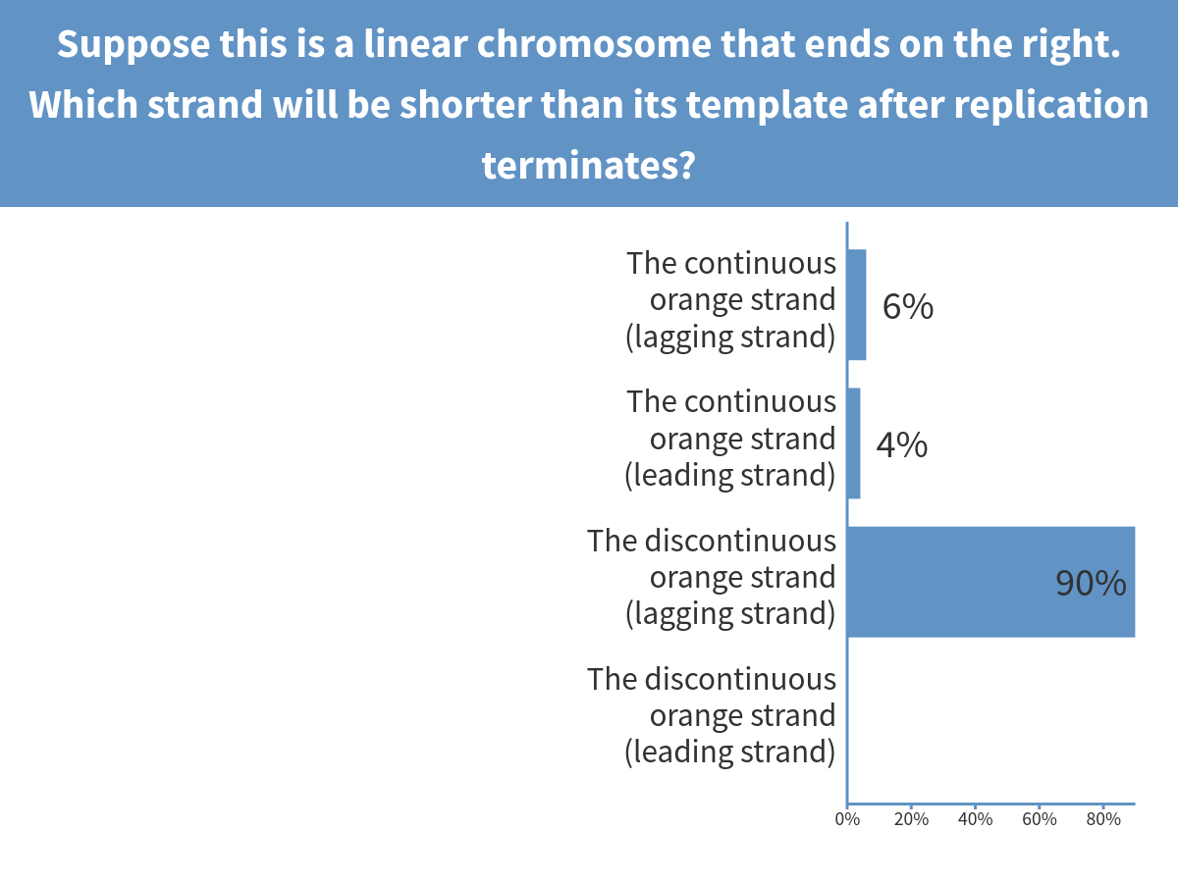
Notes:
Suppose this is a linear chromosome that ends on the right. Which strand will be shorter than its template after replication terminates?

Slide 6
Common themes in DNA damage
Sources of damage:
Internal/intrinsic sources (polymerase error, oxidative damage, alkylation, reactions catalyzed by water)
External/extrinsic sources (radiation, drugs, chemicals in the environment)
Repair mechanisms:
Direct repair
Use of complementary or homologous strands as templates for replacing damaged DNA
Consequences if unrepaired:
Mutations
Blocked DNA replication (often leading to cell death)

Slide 7
Some common causes of mismatches and DNA damage
Polymerase errors
Spontaneous hydrolysis
Cytosine deamination
Loss of base
Notes:
Note which of these lead to point mutations, which lead to replication fork stalling, strand breaks, etc.

Slide 8
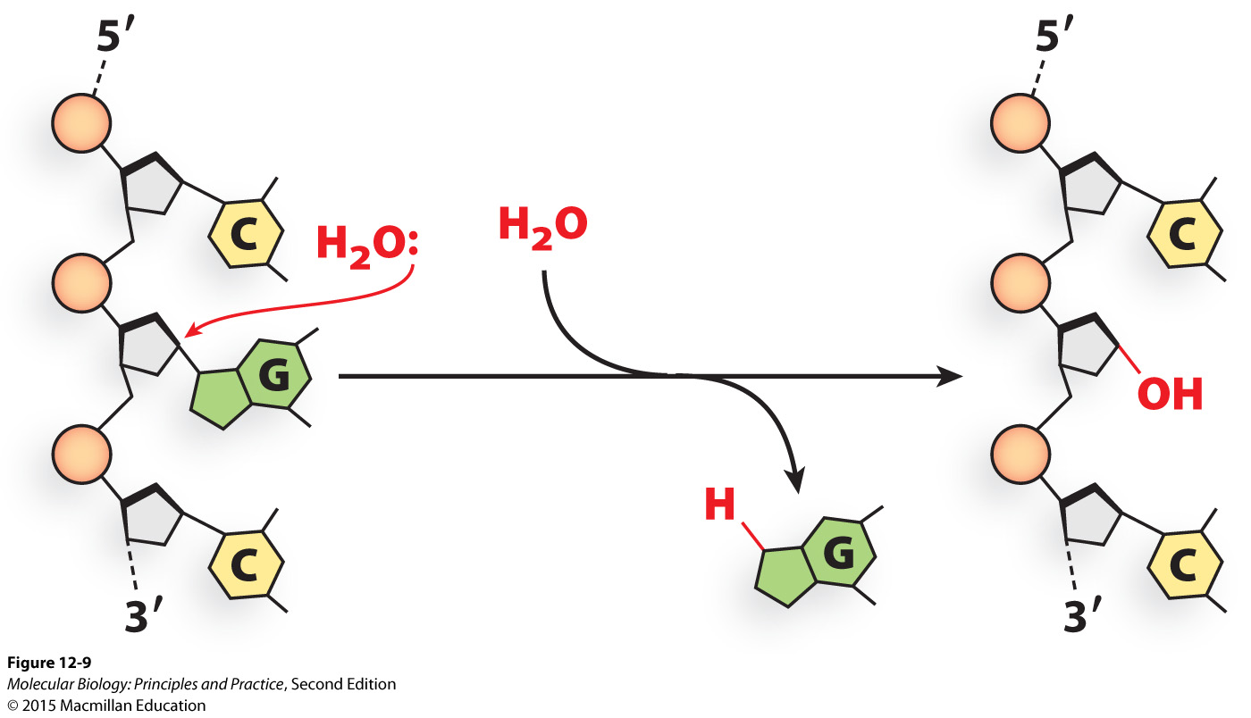
Hydrolysis of the bond linking the base to the pentose leads to abasic sites
What will happen during DNA replication if the abasic site is not repaired?
Notes:
Replication fork stalling, mutations

Slide 9
Some common causes of mismatches and DNA damage
Polymerase errors
Spontaneous hydrolysis
Cytosine deamination
Loss of base
Damage from reactive molecules produced during normal metabolism
Oxidative damage by reactive oxygen species (ROS)
Alkylation
Notes:
Note which of these lead to point mutations, which lead to replication fork stalling, strand breaks, etc.

Slide 10
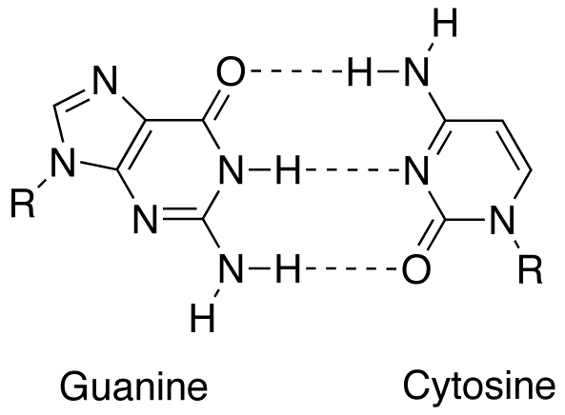
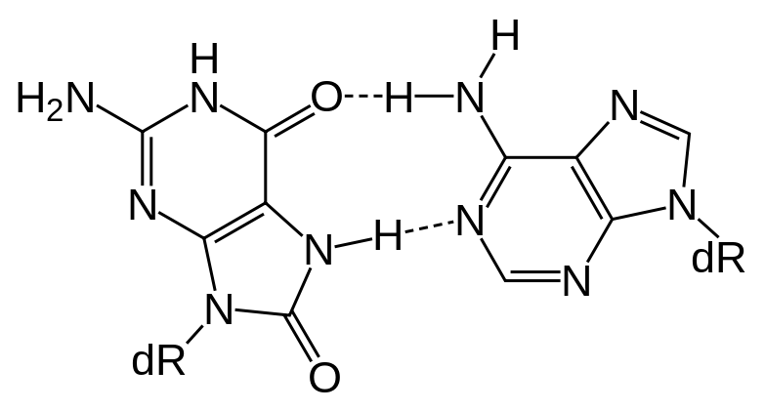
8-oxoguanine mispairs with adenine, causing mutations
Adenine
8-oxoguanine
By Fvasconcellos and Jypx3 via wikimedia commons

Slide 11
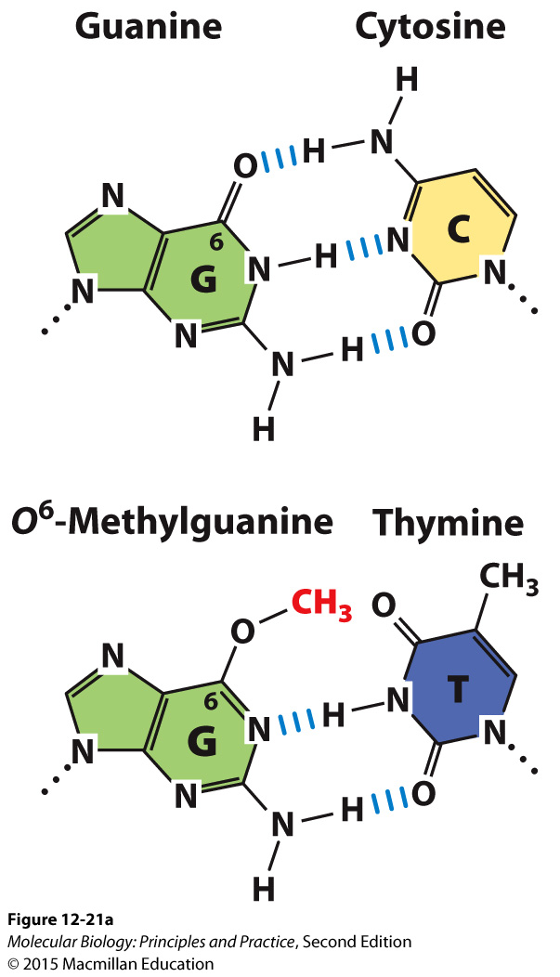
O⁶-methylguanine mispairs with thymine, causing mutations

Slide 12
Some common causes of mismatches and DNA damage
Polymerase errors
Spontaneous hydrolysis
Cytosine deamination
Loss of base
Damage from reactive molecules produced during normal metabolism
Oxidative damage by reactive oxygen species (ROS)
Alkylation
Damage from other reactive molecules and radiation
UV radiation causes bulky adducts that block replication
Ionizing radiation causes strand breaks
Notes:
Note which of these lead to point mutations, which lead to replication fork stalling, strand breaks, etc.

Slide 13
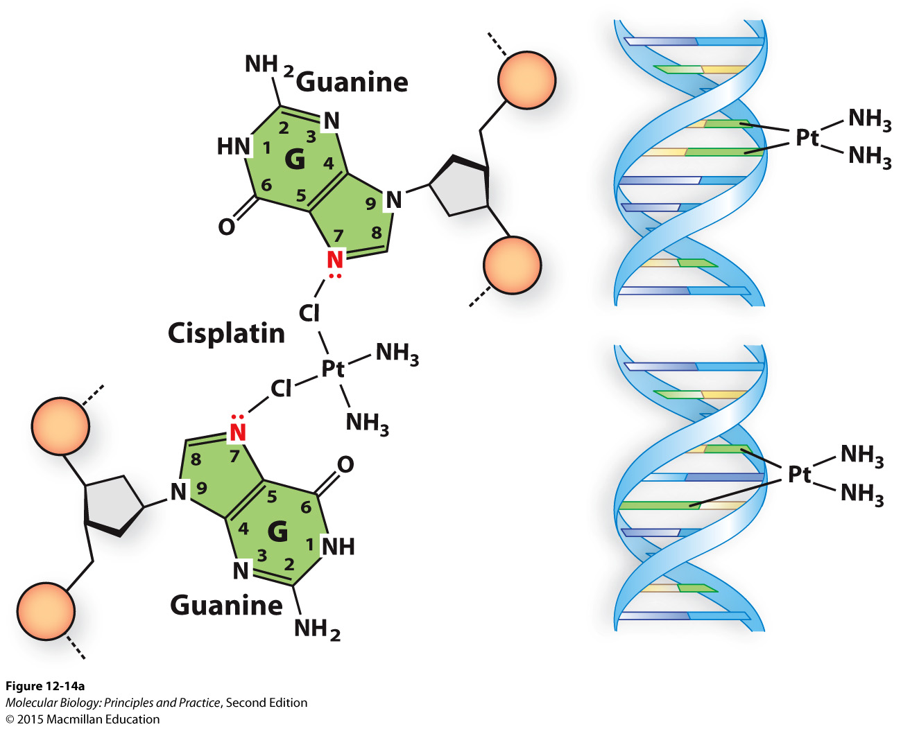
Cisplatin crosslinks bases together, blocking DNA replication and leading to death of cancer cells

Slide 14
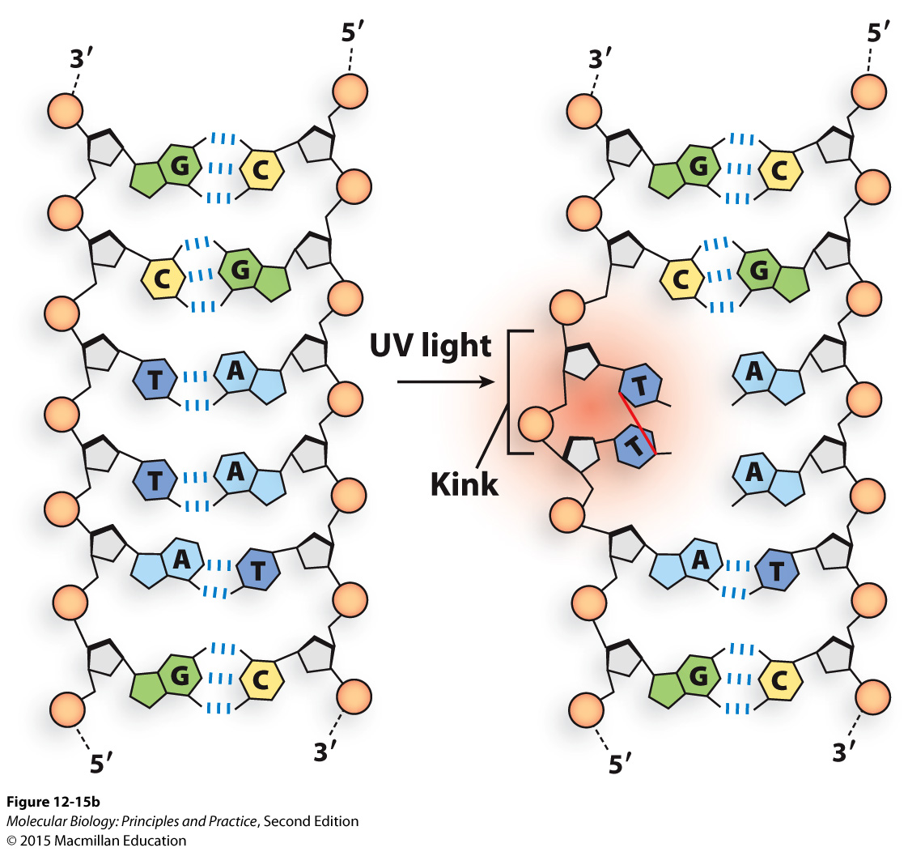
UV radiation -> thymine dimers
What will happen during DNA replication if thymine dimers are not repaired?

Slide 15
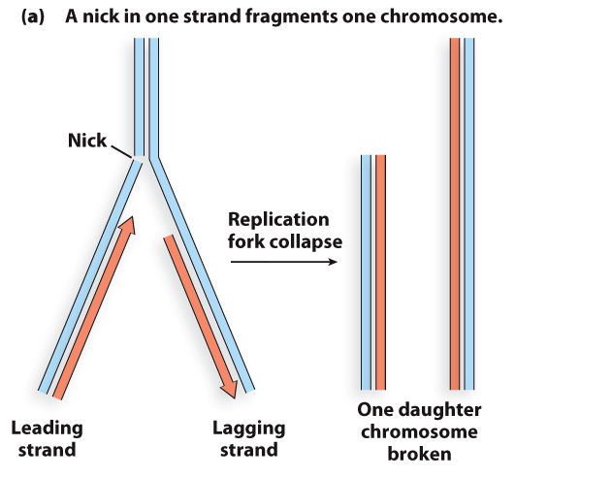
Single and double-strand breaks lead to broken chromosomes

Slide 16
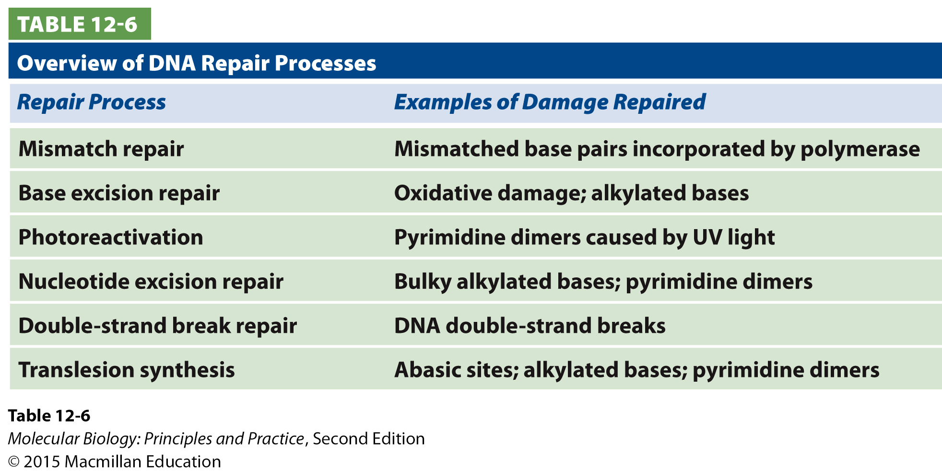
DNA repair pathways and mechanisms

Slide 17
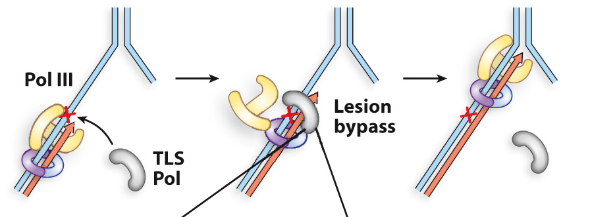
Translesion synthesis polymerases bypass damaged bases
Error-prone – often leads to mutations

